Slide 1
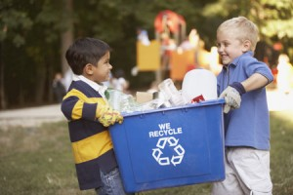
RECYCLE!
A presentation for kids

Slide 2
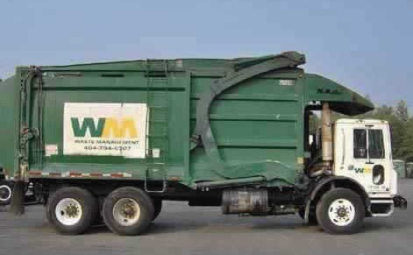
GARBAGE
More and more garbage! Every day people throw away trash. As the world population increases, more people throw away more garbage. Garbage trucks come to pick it up, but where does it all go?

Slide 3
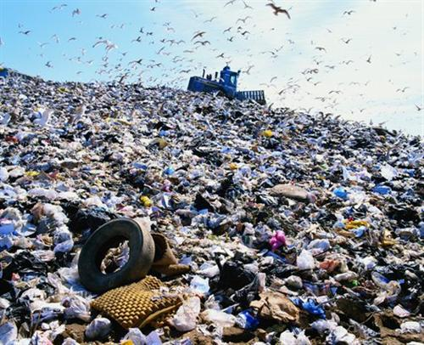
LANDFILLS
Most of the garbage is hauled away to landfills. A landfill is a place where garbage is dumped in heaps from garbage trucks.
Bulldozers push the garbage into neat piles. Then they cover it up with dirt so that animals and bugs will stay away.

Slide 4
Most people don’t want landfills near where they live. There is so much garbage now, that many landfills are running out of room. Where can it all go?
One solution is to cut down on the trash we make. This is called “REDUCE”.
Another solution is to RECYCLE. Recycling means reusing materials instead of throwing them away.

Slide 5

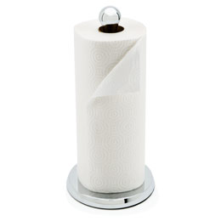
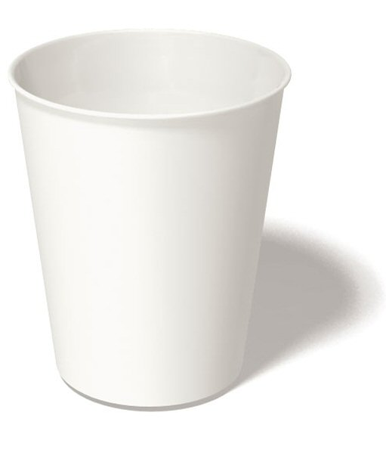
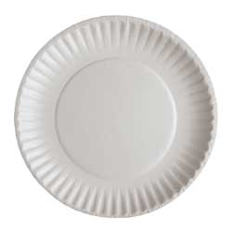
PAPER
It takes a lot of energy to make paper. People in the United States cut down 850 MILLION trees to make paper products each year.
When they cut down trees, chemicals and water are used to make pulp. The pulp is spread out on a moving screen to make a think layer of fibers. This is how paper is made.
How can you reduce the amount of paper you use?
How can you recycle paper?

Slide 6
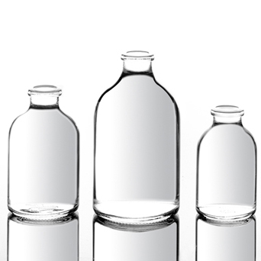
GLASS
It takes lime, soda ash, and sand called silica, to make glass. These three elements are mixed together and heated at a very high temperature to make a glassy liquid. They are sometimes dyed and dropped into forming machines to make bottles and jars.
It takes about 3,000 years for glass to biodegrade at a landfill.
How can you reduce or recycle glass?

Slide 7
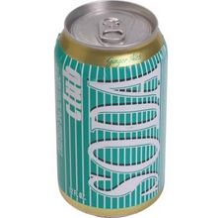
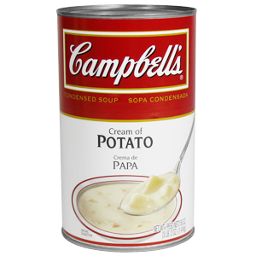
CANS
Most cans are made from aluminum. It takes many energy resources and creates pollution to produce aluminum.
Many products such as soda and food are sold in aluminum cans. Often, when the cans are empty, they are tossed away.
It takes about 500 years for aluminum to biodegrade at a landfill.
How can you reduce or recycle aluminum cans?

Slide 8
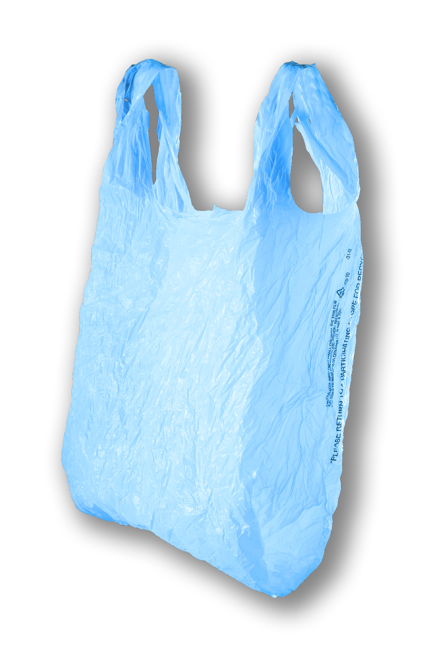
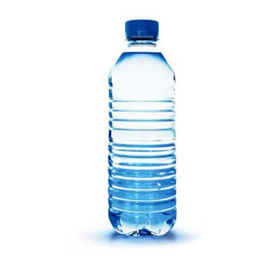
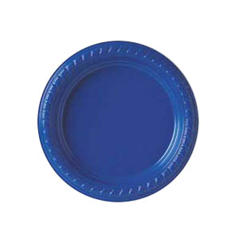
PLASTIC
Plastic is EVERYWHERE! Plastic bottles, plastic bags, plastic plates, plastic containers.
The problem with plastic is that it DOESN’T biodegrade. It lasts forever and fills landfills, litters roadsides, and harms wildlife.
How can you reduce or recycle plastic?

Slide 9
You CAN help!
What two important things can you do to help the earth?
How does recycling help?
How does reducing help?

